Slide 1
JAVA几种Reference探讨

Slide 2
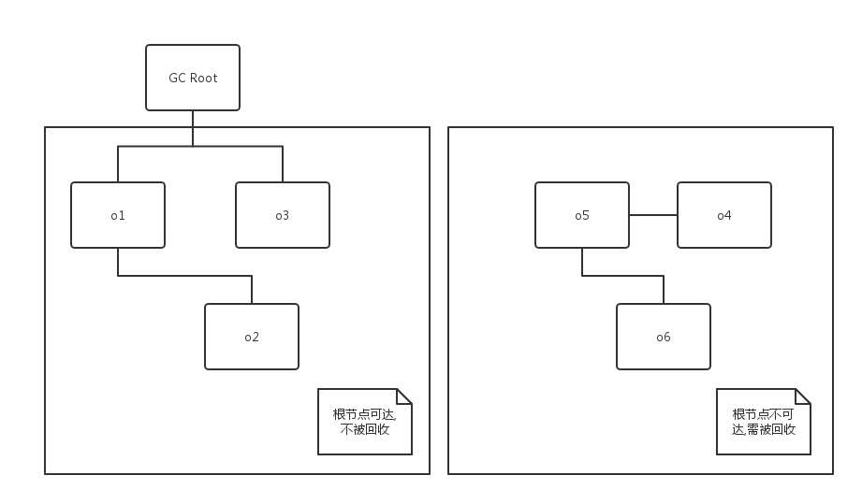
JVM GC回收逻辑
Notes:
gc roots:
Class - class loaded by system class loader. Such classes can never be unloaded. They can hold objects via static fields. Please note that classes loaded by custom class loaders are not roots, unless corresponding instances of java.lang.Class happen to be roots of other kind(s).
Thread - live thread
Stack Local - local variable or parameter of Java method
JNI Local - local variable or parameter of JNI method
JNI Global - global JNI reference
Monitor Used - objects used as a monitor for synchronization
Held by JVM - objects held from garbage collection by JVM for its purposes. Actually the list of such objects depends on JVM implementation. Possible known cases are: the system class loader, a few important exception classes which the JVM knows about, a few pre-allocated objects for exception handling, and custom class loaders when they are in the process of loading classes. Unfortunately, JVM provides absolutely no additional detail for such objects. Thus it is up to the analyst to decide to which case a certain "Held by JVM" belongs.
object1于object2之间的线条,意即
object1{
Object object=object2;
}

Slide 3
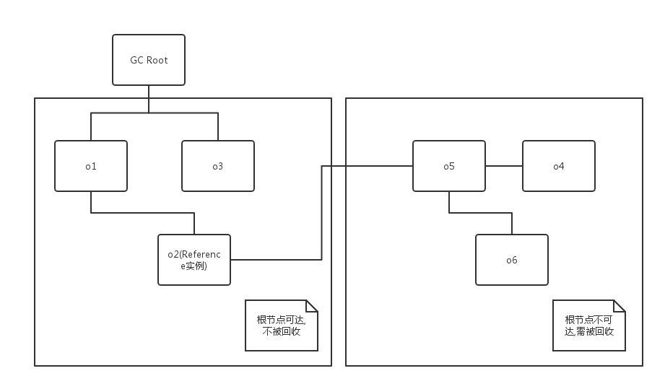
Reference引入后JVM GC回收逻辑
Notes:
o2和o5之间只有reference引用关系,JVM可以根据reference种类自主进行回收

Slide 4
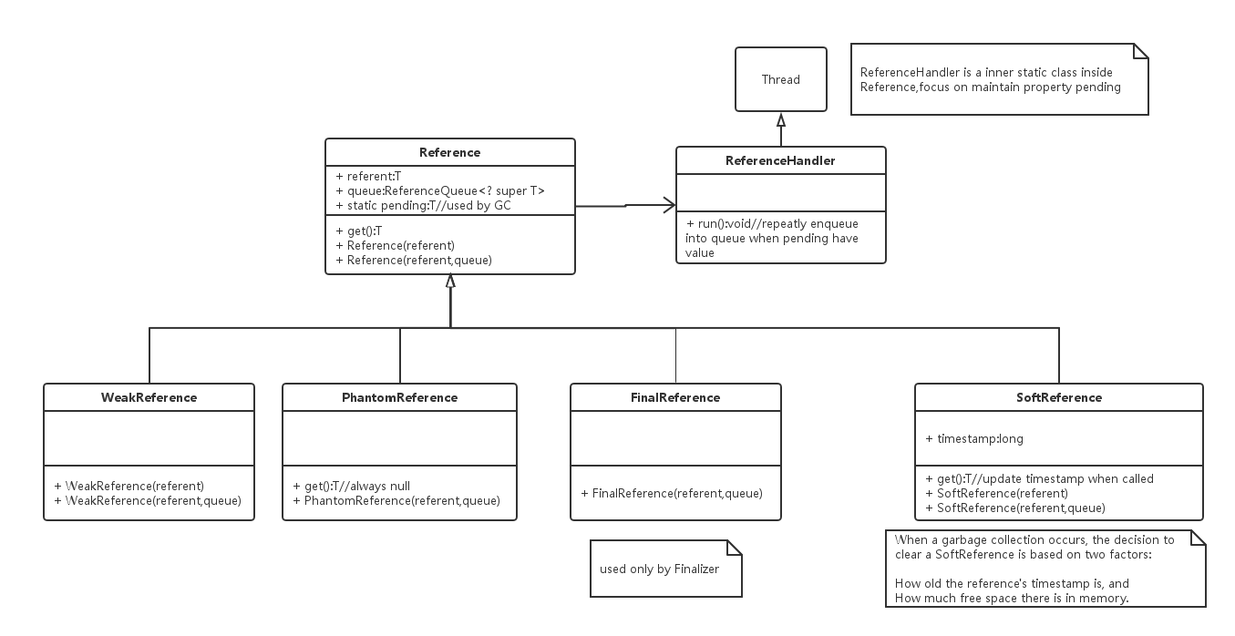

Slide 5
class Sample {
//every instance own 2K memory space
public byte[] data;
public Sample() {
this.data = new byte[1024 * 2];
Arrays.fill(data, (byte) 1);
}
}

Slide 6
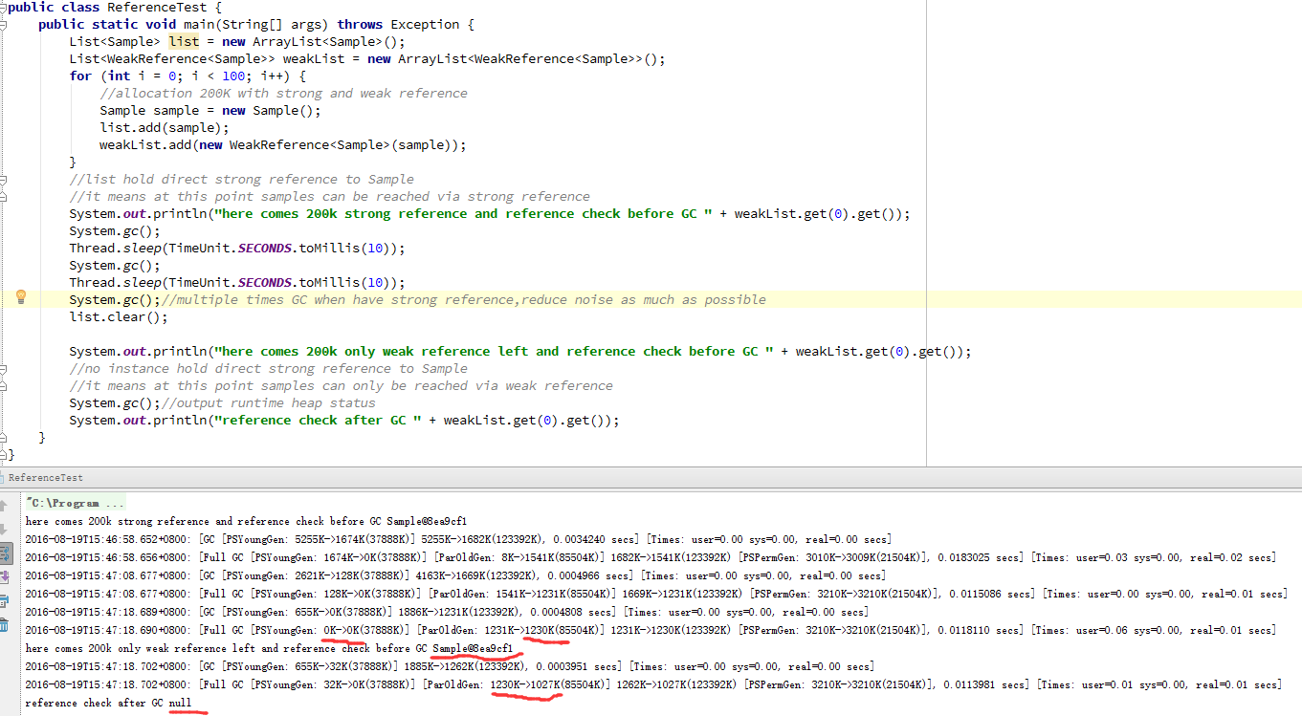
Notes:
在清空直接引用之前,多次进行GC,使samples在FULLGC之后移动到老年代,便于后续直接比较老年代的空间变化
使用WeakReference,referent的直接引用一被清空,在接下来的GC中,byte[]占用的空间200K(1230K-1027K)被回收

Slide 7
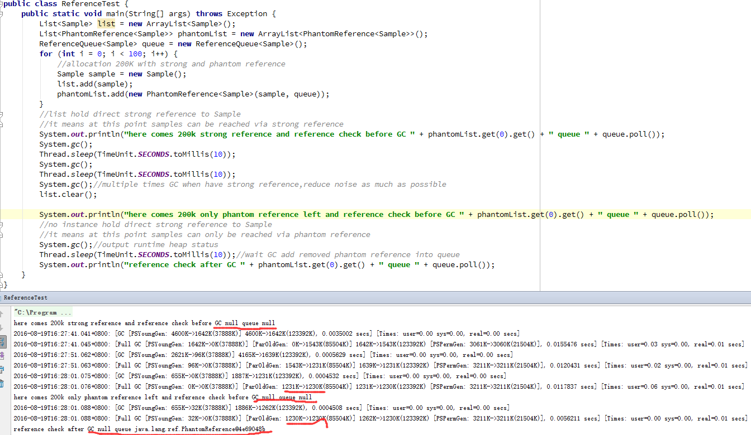
Notes:
使用PhantomReference,虽然直接引用已经清空,但是GC并没有回收byte[]的空间
在实验条件下,当执行下列操作后JVM才立即回收byte[]占用的空间
while(true){
if(queue.poll()==null){
break;
}
continue;
}
phantomList.clear();
因为所有PhantomReference(连带其中的referent)都变为GC ROOT不可达
如果PhantomReference还是GC ROOT可达状态,JVM决定其何时回收referent

Slide 8
WeakReference,当referent直接引用被清空,在接下来的GC中,referent随即被回收
PhantomReference,当referent直接引用被清空,JVM决定其何时回收referent(逻辑未知)
SoftReference,当referent直接引用被清空,JVM决定其何时回收referent(根据referent存活timestamp和当前可用空间决定是否回收)
FinalReference,仅供Finalizer使用,不做深入

